Slide 1

Batted Ball Probability Distributions
Ben Keever & Logan Donaldson

Slide 2
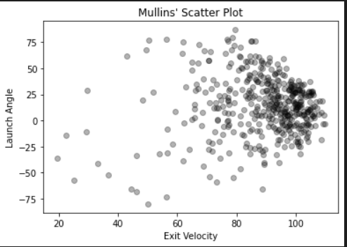
The Problem
Given a player’s bivariate batted ball data (launch angle & exit velocity) develop a methodology to fit an intuitive and accurate probability distribution to the data. The methodology must be general enough to be applicable to any player.

Slide 3
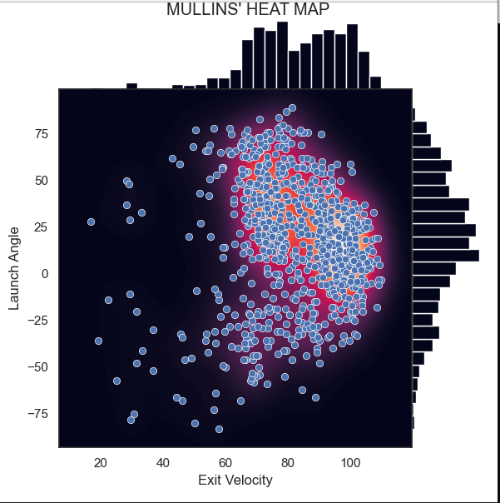
Proposed Solution #1: Kernel Density Estimate
Non-parametric approach
Continuous analog of a histogram
Extremely good approximation capable of capturing subtle nuances
Very flexible, performs well on all players
Computationally expensive
Requires all data be kept to sample/evaluate density

Slide 4
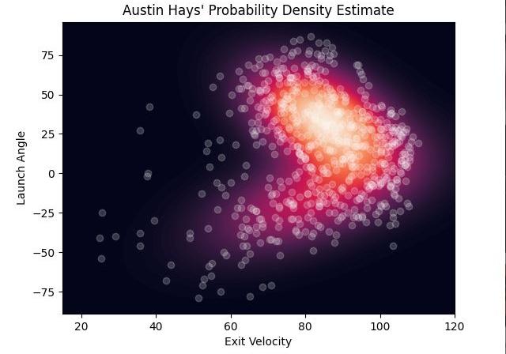
Proposed Solution #2: Gaussian Mixture Model
Parametric clustering approach
Fits a linear combination of bivariate normal distributions
Parametric approach means the distribution is independent of data once fitted
Parameters can be used a point of comparison between players
Sampling leads to erroneous values due to the long tails of the normal distribution

Slide 5
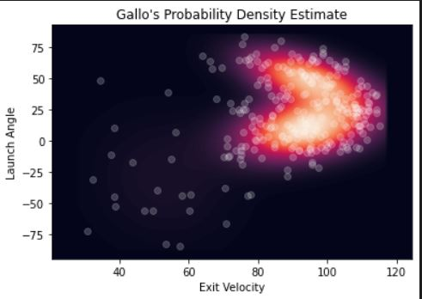
Proposed Solution #3: Gaussian Mixture Model - Thresholding
Parametric clustering approach
Fits a linear combination of bivariate normal distributions
Remove long tails once fitted and rescale distribution
Parametric approach means the distribution is independent of data once fitted
No erroneous points when sampling
Difficult to interpret and a rather “hacky,” inelegant solution

Slide 6
BBSS: Batted Ball Similarity Score
Given two players’ batted ball data fit each with a probability distribution
Overlay an identical lattice/grid over each distribution
For each point in the lattice evaluate both densities and take the absolute value of the difference
Do this for each point and sum as you go
Apply a normalization constant
BBSS(P₁,P₂) = ( Σ | (f₁(x) - (f₂(x) | ) / (n)
The result will be a value in the range [0,1] where 0 signifies two players are exactly the same

Slide 7
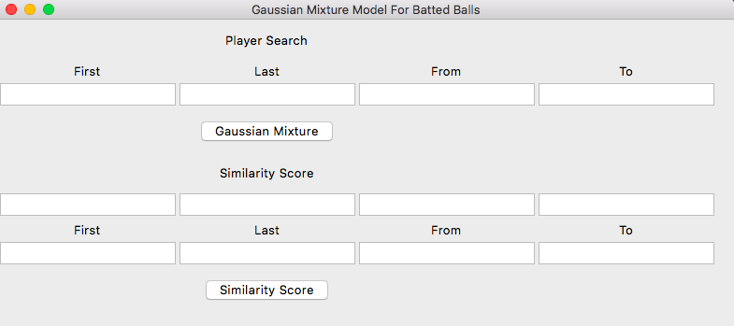
GUI Component
How can we build a simple search engine to apply our models to any player in any desired time period?
Python’s Tkinter library allows us create a basic GUI where a user can input search parameters

Slide 8
Player Search
We weren’t able to gain access to the Oriole’s database, so we had to find another way to gather player data
Ultimately landed on pybaseball, a Python package that allows users to pull historical player stats from Statcast, Baseball Reference and Fangraphs
Specifically used statcast_batter.py for this project

Slide 9
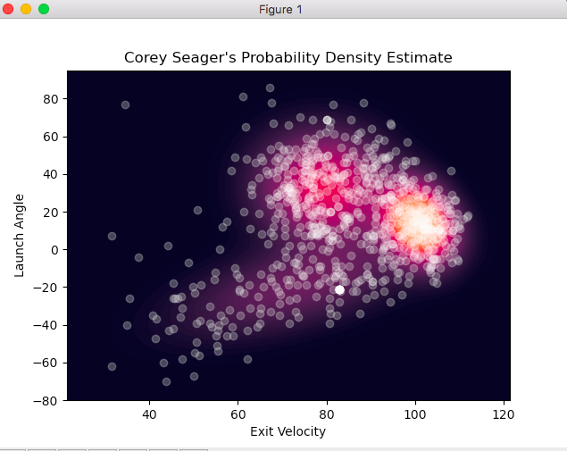
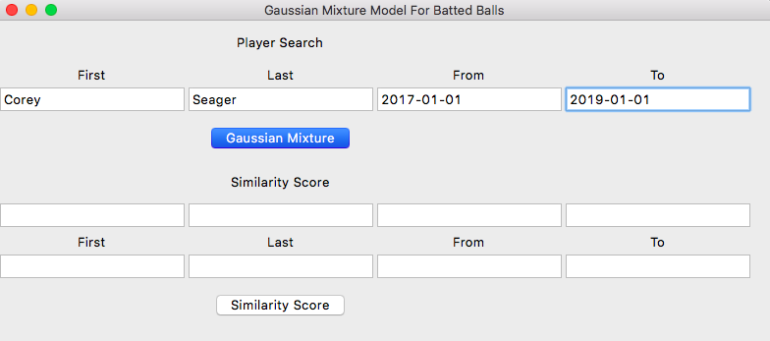
Example Search
Suppose we wanted to fit a Gaussian Mixture Model to Corey Seager’s batted balls from the 2017 and 2018 season

Slide 10
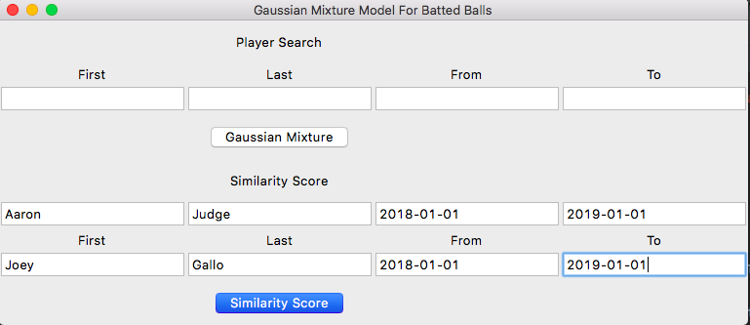
Player Comparisons Using Gaussian Mixture Estimates
Yields similarity score 0.40038

